Slide 1
BREAST CANCER DETECTION
using Machine Learning

Slide 2
by
SWARNAVA DUTTA – 380116010119
Guided by Dr. Pranati Rakshit

Slide 3
CONTENTS
TOPICS | SLIDE No
Introduction | 04
Objective | 05
Algorithms Used | 06
SVM Classifier | 07-09
Naïve Bayes Classifier | 10-11
Logistic Regression | 12-13
K Nearest Neighbour | 14-15
Decision Tree | 16-17
Random Forest Classifier | 18-19
Chi Squared Test | 20-21
Genetic Algorithm | 22-23
Implementation | 24
Result | 25-27
Conclusion | 28
Discussion | 29

Slide 4
INTRODUCTION
We present a review of recent ML approaches employed in the modeling of cancer progression. Breast Cancer becomes dangerous disease in today’s era. The most common type of this type of breast cancer is ductal carcinoma, which begins in the lining of the milk ducts. It is nothing but only thin tubes that carry milk from the lobules of the breast to the little nipple. Another type of breast cancer is lobular carcinoma, which begins in the lobules of the breast. Invasive breast cancer is breast cancer that has spread from where it began in the breast ducts or lobules to surrounding normal tissue. Breast cancer occurs in both men and women, although male breast cancer is rare.
According to the survey of in 2014, there are 232,670 females and 2,360 males having this type of new cases regarding the breast cancer. Among them 40,000 females and 430 males was death during the period this survey .These are the signs and symptoms for the early detection of the breast cancer. Machine Learning is a powerful tool and technique to handling this task. In data mining breast cancer research has been one of the important research topics in medical science during the recent years The classification of Breast Cancer data can be useful to predict the result of some diseases or discover the genetic behavior of tumors. There are many techniques to predict and classification breast cancer pattern. This paper empirically compares performance of different classification rules that are suitable for direct interpretability of their results.
Even though it is evident that the use of ML methods can improve our understanding of cancer progression, an appropriate level of validation is needed in order for these methods to be considered in the everyday clinical practice. In this work, we present a review of recent ML approaches employed in the modeling of cancer progression.

Slide 5
OBJECTIVE
The objective of our project is to predict the occurrence of breast cancer with utmost accuracy possible using different classification techniques, feature selection methods, feature importance, hypothesis and heuristic test like chi squared test and genetic algorithm.
The dataset we are using is UCI dataset which includes different physical features that is required to determine whether the person has a probability of breast cancer and how much accurate the result is (whether it is benign or malignant).

Slide 6
Algorithms Used
Support Vector Machine (SVM)
Naïve Bayes
Logistic Regression
K Nearest Neighbor
Decision Tree
Random Forest Classifier
For Feature Selection
Chi-squared Test
Genetic Algorithm

Slide 7
SUPPORT VECTOR MACHINE CLASSIFIER
The objective of the support vector machine algorithm is to find a hyperplane in an N-dimensional space (N — the number of features) that distinctly classifies the data points.
To separate the two classes of data points, there are many possible hyperplanes that could be chosen. Our objective is to find a plane that has the maximum margin, i.e the maximum distance between data points of both classes. Maximizing the margin distance provides some reinforcement so that future data.
We used Support Vector Machine classifier in our project. Using this classifier the accuracy are 97.36% (with normalization) and 94.73% (without normalization).

Slide 8
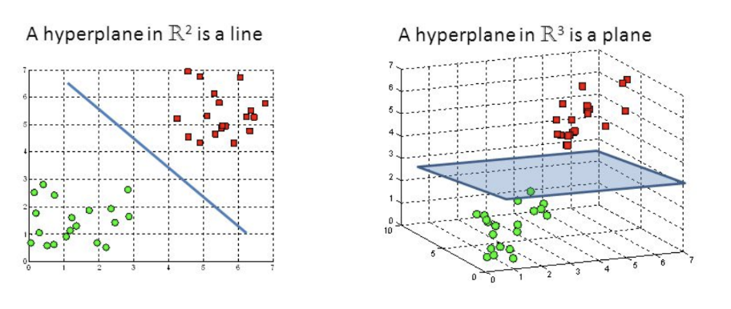
Hyperplanes are decision boundaries that help classify the data points. Data points falling on either side of the hyperplane can be attributed to different classes. Also, the dimension of the hyperplane depends upon the number of features. If the number of input features is 2, then the hyperplane is just a line. If the number of input features is 3, then the hyperplane becomes a two-dimensional plane. It becomes difficult to imagine when the number of features exceeds 3.
Support vectors are data points that are closer to the hyperplane and influence the position and orientation of the hyperplane. Using these support vectors, we maximize the margin of the classifier. Deleting the support vectors will change the position of the hyperplane. These are the points that help us build our SVM.

Slide 9
ADVANTAGES & DISADVANTAGES
Advantage
SVM works relatively well when there is clear margin of separation between classes.
SVM is more effective in high dimensional spaces.
Disadvantage
SVM algorithm is not suitable for large data sets.
SVM does not perform very well, when the data set has more noise i.e. target classes are overlapping.

Slide 10
NAIVE BAYES CLASSIFIER
Naive Bayes classifier is a supervised machine learning algorithm that uses the Bayes Theorem, which assumes that features are statistically independent. The theorem relies on the naive assumption that input variables are independent of each other, i.e. there is no way to anything about other variables when given an additional variable. Regardless of this assumption, it has proven itself to be a classifier with good results.
We used Naïve bayes classifier in our project. Using this classifier the accuracy are 95.61% (with normalization) and 95.61% (without normalization).

Slide 11
ADVANTAGES & DISADVANTAGES
Advantage
They are very easy for implementing.
For estimating the parameters they only needs a very few amount training data.
Disadvantage
Chance of loss of accuracy.
Naïve Bayes classifier cannot modify dependencies because dependencies exist between variables.

Slide 12
LOGISTIC REGRESSION
Logistic Regression was used in the biological sciences in early twentieth century. It was then used in many social science applications. Logistic Regression is used when the dependent variable(target) is categorical.
Consider a scenario where we need to classify whether an email is spam or not. If we use linear regression for this problem, there is a need for setting up a threshold based on which classification can be done. Say if the actual class is malignant, predicted continuous value 0.4 and the threshold value is 0.5, the data point will be classified as not malignant which can lead to serious consequence in real time.
From this example, it can be inferred that linear regression is not suitable for classification problem. Linear regression is unbounded, and this brings logistic regression into picture. Their value strictly ranges from 0 to 1.

Slide 13
ADVANTAGES & DISADVANTAGES
Advantage
Logistic Regression performs well when the dataset is linearly separable.
Logistic regression is less prone to over-fitting but it can overfit in high dimensional datasets. You should consider Regularization (L1 and L2) techniques to avoid over-fitting in these scenarios.
Disadvantage
Main limitation of Logistic Regression is the assumption of linearity between the dependent variable and the independent variables. In the real world, the data is rarely linearly separable. Most of the time data would be a jumbled mess.SVM does not perform very well, when the data set has more noise i.e. target classes are overlapping.
If the number of observations are lesser than the number of features, Logistic Regression should not be used, otherwise it may lead to overfit.

Slide 14
K-Nearest Neighbours (KNN)
K-nearest neighbours (KNN) algorithm is a type of supervised ML algorithm which can be used for both classification as well as regression predictive problems. However, it is mainly used for classification predictive problems in industry. The following two properties would define KNN well −
Lazy learning algorithm − KNN is a lazy learning algorithm because it does not have a specialized training phase and uses all the data for training while classification.
Non-parametric learning algorithm − KNN is also a non-parametric learning algorithm because it doesn’t assume anything about the underlying data.

Slide 15
ADVANTAGES & DISADVANTAGES
Advantage
No Training Period: KNN is called Lazy Learner (Instance based learning). It does not learn anything in the training period. It does not derive any discriminative function from the training data. In other words, there is no training period for it. It stores the training dataset and learns from it only at the time of making real time predictions. This makes the KNN algorithm much faster than other algorithms that require training e.g. SVM, Linear Regression etc.
New data can be added seamlessly which will not impact the accuracy of the algorithm
Disadvantage
Does not work well with large dataset: In large datasets, the cost of calculating the distance between the new point and each existing points is huge which degrades the performance of the algorithm.
Does not work well with high dimensions: The KNN algorithm doesn't work well with high dimensional data because with large number of dimensions, it becomes difficult for the algorithm to calculate the distance in each dimension.

Slide 16
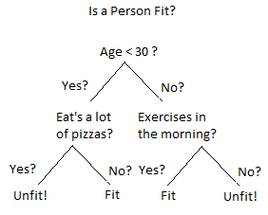
Decision Tree
Theory
Decision tree classifiers are utilized as a well known classification technique in different pattern recognition issues, for example, image classification and character recognition. Decision tree classifiers perform more successfully, specifically for complex classification problems, due to their high adaptability and computationally effective features.
Decision Tree consists of :
Nodes : Test for the value of a certain attribute.
Edges/ Branch : Correspond to the outcome of a test and connect to the next node or leaf.
Leaf nodes : Terminal nodes that predict the outcome (represent class labels or class distribution)
There are two main types of Decision Trees:
Classification Trees.
Regression Trees.
1. Classification trees (Yes/No types) :
What we’ve seen above is an example of classification tree, where the outcome was a variable like ‘fit’ or ‘unfit’. Here the decision variable is Categorical/ discrete.
Such a tree is built through a process known as binary recursive partitioning. This is an iterative process of splitting the data into partitions, and then splitting it up further on each of the branches.
2. Regression trees (Continuous data types) :
Decision trees where the target variable can take continuous values (typically real numbers) are called regression trees. (e.g. the price of a house, or a patient’s length of stay in a hospital)

Slide 17
ADVANTAGES & DISADVANTAGES
Advantage
Compared to other algorithms decision trees requires less effort for data preparation during pre-processing.
A decision tree does not require normalization of data.
A decision tree does not require scaling of data as well.
Missing values in the data also does NOT affect the process of building decision tree to any considerable extent.
A Decision trees model is very intuitive and easy to explain to technical teams as well as stakeholders.
Disadvantage
A small change in the data can cause a large change in the structure of the decision tree causing instability.
For a Decision tree sometimes calculation can go far more complex compared to other algorithms.
Decision tree often involves higher time to train the model.
Decision tree training is relatively expensive as complexity and time taken is more.
Decision Tree algorithm is inadequate for applying regression and predicting continuous values.

Slide 18
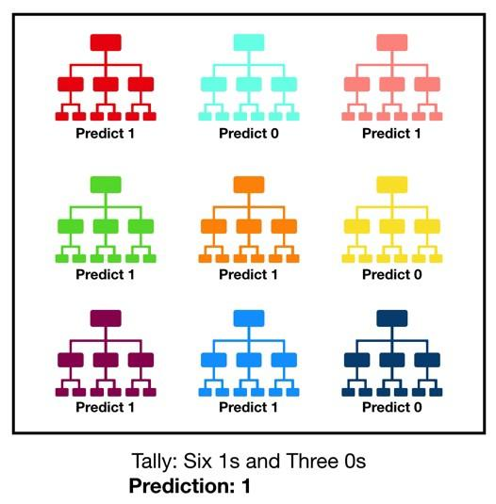
Random Forest Classifier
Random forest, like its name implies, consists of a large number of individual decision trees that operate as an ensemble. Each individual tree in the random forest spits out a class prediction and the class with the most votes becomes our model’s prediction .
A large number of relatively uncorrelated models (trees) operating as a committee will outperform any of the individual constituent models.
The low correlation between models is the key. Just like how investments with low
correlations (like stocks and bonds) come together to form a portfolio that is greater than the sum of its parts, uncorrelated models can produce ensemble predictions that are more accurate than any of the individual predictions. The reason for this wonderful effect is that the trees protect each other from their individual errors (as long as they don’t constantly all err in the same direction).

Slide 19
ADVANTAGES & DISADVANTAGES
Advantage
Random Forest can be used to solve both classification as well as regression problems.
Random Forest works well with both categorical and continuous variables.
Disadvantage
Complexity: Random Forest creates a lot of trees (unlike only one tree in case of decision tree) and combines their outputs. By default, it creates 100 trees in Python sklearn library. To do so, this algorithm requires much more computational power and resources. On the other hand decision tree is simple and does not require so much computational resources.
Longer Training Period: Random Forest require much more time to train as compared to decision trees as it generates a lot of trees (instead of one tree in case of decision tree) and makes decision on the majority of votes.

Slide 20
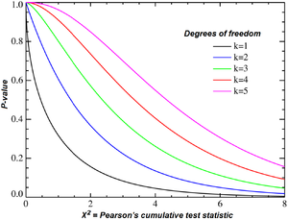
CHI-SQUARED TEST
Theory
The term "chi-squared test," also written as χ² test, refers to certain types of statistical hypothesis tests that are valid to perform when the test statistic is chi-squared distributed under the null hypothesis. Often, however, the term is used to refer to Pearson's chi-squared test and variants thereof. Pearson's chi-squared test is used to determine whether there is a statistically significant difference (i.e., a magnitude of difference that is unlikely to be due to chance alone) between the expected frequencies and the observed frequencies in one or more categories of a so-called contingency table.
In the standard applications of this test, the observations are classified into mutually exclusive classes. If the so-called null hypothesis is true, the test statistic computed from the observations follows a χ² distribution. The purpose of the test is to evaluate how likely the observed frequencies would be assuming the null hypothesis is true.
Test statistics that follow a χ² distribution occur when the observations are independent and normally distributed, which assumptions are often justified under the central limit theorem. There are also χ² tests for testing the null hypothesis of independence of a pair of random variables based on observations of the pairs.

Slide 21
ADVANTAGES & DISADVANTAGES
Advantage
Can test association between variables
Identifies differences between observed and expected values
Disadvantage
Can't use percentages
Data must be numerical

Slide 22
GENETIC ALGORITHM
Theory
Genetic algorithms (GA) like neural networks are biologically inspired and represent a new computational model having its roots in evolutionary sciences. Usually GAs represent an optimization procedure in a binary search space, and unlike traditional hill climbers they do not evaluate and improve a single solution but a set of solutions or hypotheses, a so-called population. The GAs produce successor hypotheses by mutation and recombination of the best currently known hypotheses. Thus, at each iteration a part of the current population is replaced by offspring of the most fit hypotheses.
A living being is only a decoded structure of the chromosomes. Natural selection is the link between chromosomes and the performance of their decoded structures. In genetic algorithms the design variables or features that characterize an individual are represented in an ordered list called a string. Each design variable corresponds to a gene and the string of genes corresponds to a chromosome. A group of chromosomes is called a population. During each iterative procedure (referred to as generation), a new set of strings with improved performance is generated using three GA operators (namely, reproduction, crossover, and mutation).
Five phases are considered in a genetic algorithm are:
Initial population
Fitness function
Selection
Crossover
Mutation

Slide 23
ADVANTAGES & DISADVANTAGES
Advantage
It can find fit solutions in a very less time. (fit solutions are solutions which are good according to the defined heuristic)
The random mutation guarantees to some extent that we see a wide range of solutions.
Disadvantage
Its hard for people to produce a good heuristic which actually reflects what we want the algorithm to do.
It might not find the most optimal solution to the defined problem in all cases.

Slide 24
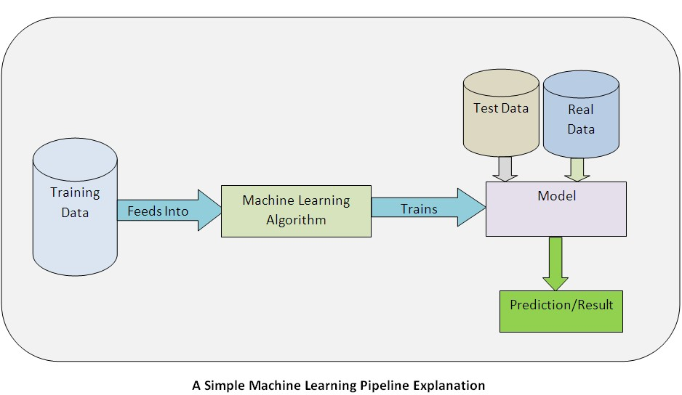
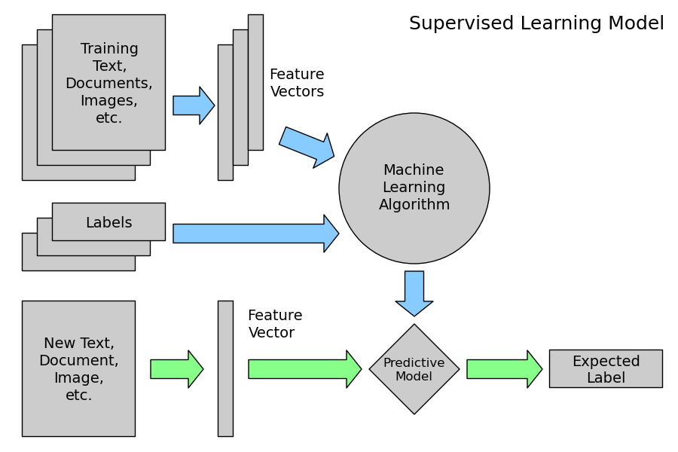
IMPLEMENTATION

Slide 25
RESULT
With Normalization
Features Used
S.no | Specs | Score
1 | Mean radius | 266.104917
2 | Mean texture | 93.897508
3 | Mean perimeter | 2011.102864
4 | Mean area | 53991.655924
5 | Mean smoothness | 0.149899
6 | Mean compactness | 5.403075
7 | Mean concavity | 19.712354
8 | Mean concave points | 10.544035
9 | Mean symmetry | 0.257380
10 | Mean fractal dimension | 0.000074
11 | Radius error | 34.675247
12 | Texture error | 0.009794
13 | Perimeter error | 250.571896
14 | Area error | 8758.504705
15 | Smoothness error | 0.003266
16 | Compactness error | 0.613785
17 | Concavity error | 1.044718
18 | Concave point error | 0.305232
19 | symmetry error | 0.000080
20 | fractal dimension error | 0.006371
21 | Worst radius | 491.689157
22 | Worst texture | 174.449400
23 | Worst perimeter | 3665.035416
24 | Worst area | 112598.431564
25 | Worst smoothness | 0.397366
26 | worst compactness | 19.314922
27 | worst concavity | 39.516915
28 | worst concave points | 13.485419
29 | worst symmetry | 1.298861
30 | Worst fractal dimension | 0.231522
Algorithm | Accuracy
Support vector machine classifier | 96.49%
2. Logistic regression | 45.61%
3. K-nearest neighbor classifier | 57.89%
4. Naïve Bayes | 93.86%
5. Decision tree | 75.44%
6. Random forest classifier | 75.44%
Without Normalization
Algorithm | Accuracy
Support vector machine classifier | 93.86%
2. Logistic regression | 95.61%
3. K-nearest neighbor classifier | 93.85%
4. Naïve Bayes | 94.74%
5. Decision tree | 94.74%
6. Random forest classifier | 97.37%

Slide 26
Final 15 features
The Chi Square statistic is commonly used for testing relationships between categorical variables .The null hypothesis of the Chi-Square test is that no relationship exists on the categorical variables in the population; they are independent. After performing chi Square Test we are getting the accuracy of 98.24%.
Final 15 features are selected after selecting common features for chi squared test. The features are taken into account for their best score.
S.no | specs | score
1 | Worst area | 112598.431564
2 | Mean area | 53991.655924
3 | Area error | 8758.504705
4 | Worst perimeter | 3665.035416
5 | Mean perimeter | 2011.102864
6 | Worst radius | 491.689157
7 | Mean radius | 266.104917
8 | Perimeter error | 250.571896
9 | Worst texture | 174.449400
10 | Mean texture | 93.897508
11 | Worst concavity | 39.516915
12 | Radius error | 34.675247
13 | Mean concavity | 19.712354
14 | Worst compactness | 19.314922
15 | Worst concave points | 13.485419
After applying Chi Square Test
Classifiers | Accuracy without normalization | Accuracy with normalization
Support vector machine classifier | 92.98% | 98.24%
2. Logistic regression | 94.73% | 36.84%
3. K-nearest neighbor classifier | 93.85% | 57.89%
4. Naïve Bayes | 95.61% | 95.61%
5. Decision tree | 95.61% | 92.98%
6. Random forest classifier | 97.36% | 63.15%

Slide 27
Best 9 features
After selecting the best 9 features from the attributes table, genetic algorithm is used to get the accuracy
Sl.No | Specs | Score
1 | Worst area | 112598.431564
2 | Mean area | 53991.655924
3 | Area error | 8758.504705
4 | Worst perimeter | 3665.035416
5 | Mean perimeter | 2011.102864
6 | Worst radius | 491.689157
7 | Mean radius | 266.104917
8 | Perimeter error | 250.571896
9 | Worst texture | 174.449400
After applying Genetic Algorithm
Classifiers | Accuracy without normalization | Accuracy with normalization
Support vector machine classifier | 94.77% | 97.37%
Logistic regression | 94.74% | 42.11%
K-nearest neighbor classifier | 92.98% | 57.89%
Naive Bayes | 95.61% | 95.61%
Decision tree | 95.61% | 57.89%
Random forest classifier | 96.49% | 57.89%

Slide 28
CONCLUSION
Comparing to all other cancers, breast cancer is one of the major causes of death in women. So, the early detection of breast cancer is needed in reducing life losses. In this paper we have applied techniques namely feature selection, feature extraction, and classification to further optimize the feature model and increasing the accuracy It helps in predicting the breast cancer as accurately as possible.
Our study reveals that Support Vector Machine Classifier gives the maximum accuracy of 96.49% and Logistic Regression gives the lowest accuracy of 45.61% without using feature selection.
After using CHI SQUARED TEST we get accuracy of 98.24% and 36.84% respectively.
After using GENETIC ALGORITHM we get accuracy of 97.37% and 42.11% respectively.
This work can further be enhanced by identification of breast cancer, can be done in near future.

Slide 29
DISCUSSION
The use of feature selection, genetic algorithm improves the accuracy of the features as only the best features are used for the algorithm to run. The work can be further be improved in future by categorizing the features to get more accurate results

